Slide 1



Team No. 9
Submitted to
Dr Yasser Saad, Dr Mostafa Abdelkhalek
Senior 2 Mechatronics program

Slide 2
Overview
What is Heat Exchanger?
Heat Exchanger Types
Heat Exchanger Tube Failure
Radiator in Car
Calculations
Radiator Thermal Shock (Situation Control)
Flow Chart

Slide 3
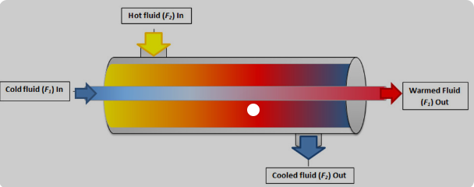
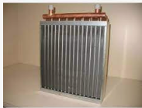
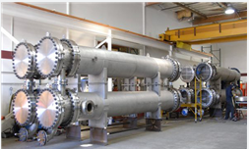
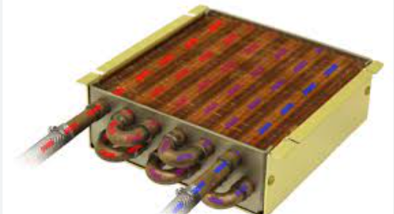
ر
What is Heat Exchanger
Process: in simplest, heat exchanging
Between cold and hot fluids (or fluid
With body.
Cooling and heating
Applications
Heat exchanging process
radiator
Chemical industry
In electronics

Slide 4
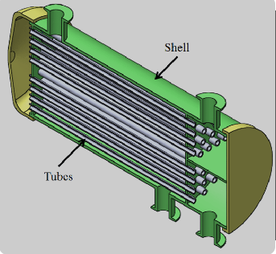
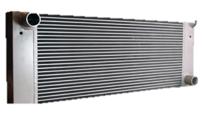
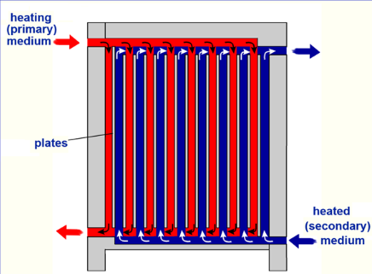
ر
Heat Exchanger Types
Shell and Tube
  Many small tubes
  Fixed to body or
  floating (removable)
Air cooled
  Cooling air provided by fan
  When no permanent cooler available
  Used in vehicles and automobiles
Plate Type
  Plates instead of tubes
  Preferred in refrigerants

Slide 5

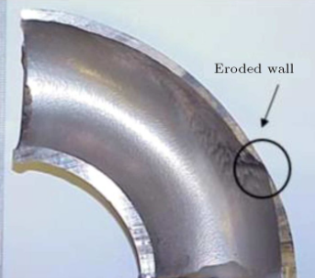
ر
Heat Exchanger Tube Failure
Tube Corrosion
  Common with carbon steel tubes
Tube Erosion
  Tubes wearing
  Caused by fluids with high dissolved solids
  Often at U-bend tubes or inlet tubes
    U-bend: due to change in flow direction resisting fluid force
    Inlet: due to turbulent flow at inlet
corrosion
Erosion at elbow

Slide 6
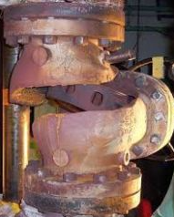

ر
Heat Exchanger Tube Failure
Water Hammer
  Very rare
  Detected by internal inspection or leakage
Thermal Fatigue
  Happens at high temperature differentials
  Due to accumulative cyclic thermal caused stresses
  Diagnosed only after failure occurs
Water hammer
Thermal fatigue failure

Slide 7
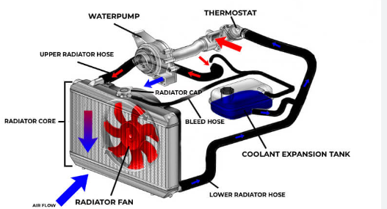
ر
Radiator in Car
Why?
  Engine generates heat while burning fuel, venting this heat away is a must to prevent engine damage.
How?
  One cooling cycle:
  Thermostat detects excess heat >>> coolant and water released from radiator >>>
  Picks up excess heat then sent back to radiator >>> blow air across it to cool it down

Slide 8

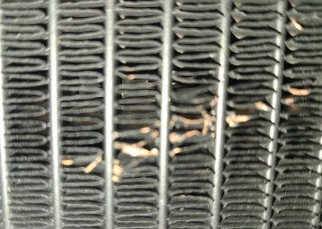
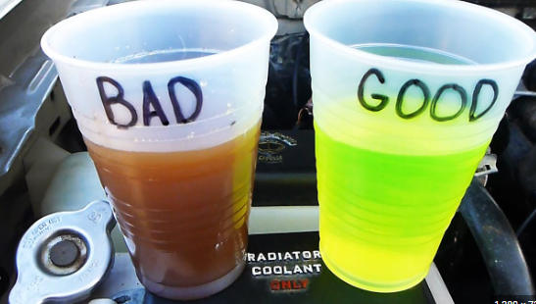
ر
Radiator in Car
Signs of radiator failure
  Leakage coolant: low level coolant or leakage under vehicle
  Discolored coolant: change in color because of rust and debris
  Bent or damaged fins: block air flow
leakage
Discolored coolant
Damaged fins

Slide 9
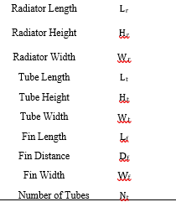
ر
Calculations
Assumptions:
  Steady state conditions & constant flow rate
  No phase change in coolant fluid
  Pure water used as coolant
  Constant thermal conductivity for radiator material
  Heat conduction in wall is negligible
parameters

Slide 10





ر
Calculations
Important Equations

Slide 11

ر
Thermal Shock
What is it?
  At high temperature change metal can expand and flex, this happening repeatedly at same area fatigue the material and can cause component failure.
  As seen from equation, E & alpha
  Are constants, thermal stress increases with high temperature difference.
Thermal stress equations

Slide 12
ر
Thermal Shock
How to avoid thermal shock?
  Use the equation to get maximum allowed temperature difference for the material, implement a control process to prevent the system from going to this temperature.
Thermal stress equations

Slide 13
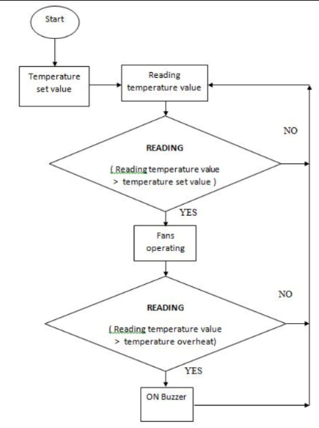
ر
Flow Chart

